Slide 1
APPLICATION OF SPECTRAL SHAPING FOR SIMULATING NUCLEAR WEAPON ENVIRONMENTS
Capt Nick Quartemont
MS Nuclear Engineering 19M
Air Force Institute of Technology
1 November 2018

Slide 2
Overview
Motivation
Objectives and Current Status
Prospectus Recap
Current Results
Path Forward

Slide 3


Motivation
Deterrence
Nuclear weapons effects (Surety)
Technical Nuclear Forensics (Attribution)
2018 Nuclear Posture Review key efforts in countering nuclear terrorism “deterring state support for nuclear terrorism through advanced forensics and attribution capabilities.”
Notes:
The technical nuclear forensics (TNF) community requires the ability to general representative post-detonation debris samples for training and development of attribution techniques. The generation of accurate fission product inventories in the representative debris is both extremely important for the attribution of the origin of a nuclear device and very difficult to do with existing facilities.
Additionally, an important nuclear weapon testing related mission is radiation effects on electronics in nuclear systems. The current neutron sources do not have an accurate energy or temporal distribution for the nuclear environment that nuclear systems are required to survive in certification testing. This problem is complicated further as the transmitted neutron flux through the physical environment and to the target varies significantly in energy and temporal distribution depending on the scenario and system being considered. To address this capability gap, it would be beneficial to have a testing capability with an accurate temporal profile.

Slide 4
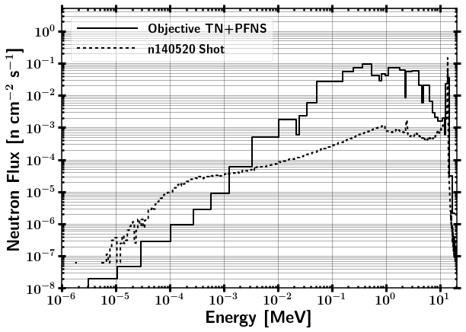
Research Objectives
Research Question:
Can we produce an accurate neutron energy distribution expected from a "typical" thermonuclear or boosted nuclear weapon detonation using spectral modification at the NIF?

Slide 5
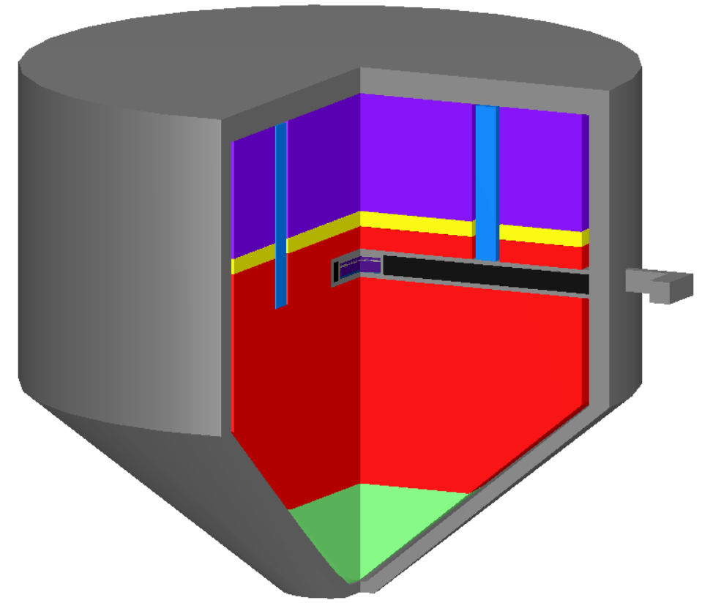
Research Objectives
Quantify the impact of nuclear data covariance on the neutron energy spectrum, foil activation rates, and fission product production
Design a foil activation diagnostic pack to provide larger energy resolution for unfolding the neutron flux
Estimate fission product production

Slide 6
Objectives / Current Status
Objective | Percent Complete
Finalize MCNP Design | 100%
Finalize SCALE Design | 100%
Selection of Activation Foils / Coverage for Unfolding | 100%
Run SCALE SAMPLER | ~50% (120 / 300 Samples)
STAYSL Unfolding | 100%*
GEF Fission Products | 100%*
Nagy Fits – Fission Products | 50%
Short Pulse Neutron Source Characterization | 50%
Impact of nuclear data covariance | 90%
* ETA results will be finalized when SAMPLER results have fully converged. Setup now so that results available in approximately 1 hour after completion of SAMPLER.

Slide 7
Objectives / Current Status
Objective | Percent Complete
Chapter 1 | 95%
Written Thesis | 35%
NSSMIC Conference Poster | 100%
HEART Conference Presentation | 50% (Still need to be accepted)
Submit to Transactions on Nuclear Science | 50%

Slide 8
Assumptions and Limitations
Nuclear data (and uncertainty in the uncertainty)
Unclassified nuclear weapon spectrum – Thermonuclear and Prompt Fission Neutron Spectrum (TN+PFNS)
NIF neutron source
Nuclear weapon environment
Not analyzed at weapon temperatures
No temporal dependence
No fractionation

Slide 9
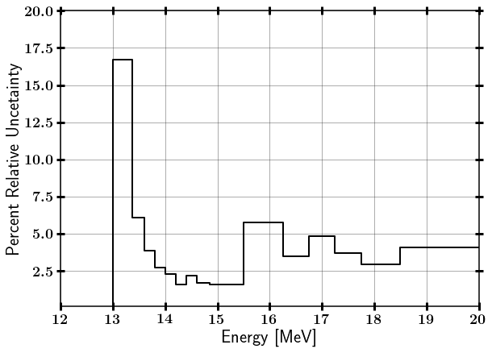
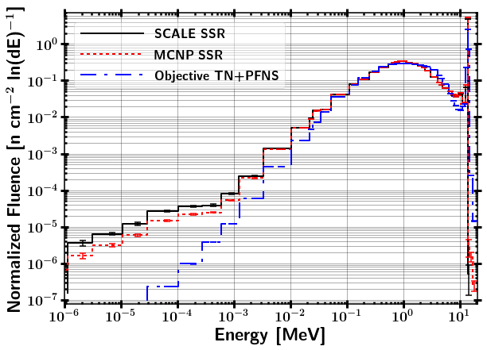
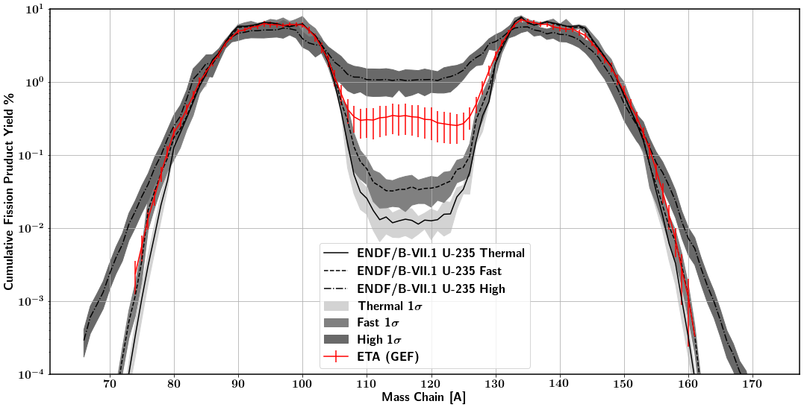
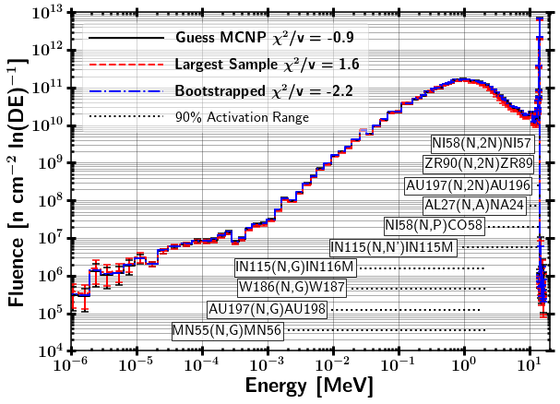
Summary of Main Theory Utilized
Nuclear Data Covariance and Statistical Bootstrapping
Neutron Interactions with Matter
Monte Carlo Neutron Transport
Fission Theory Fission Products
Foil Activation and Neutron Energy Spectrum Unfolding

Slide 10
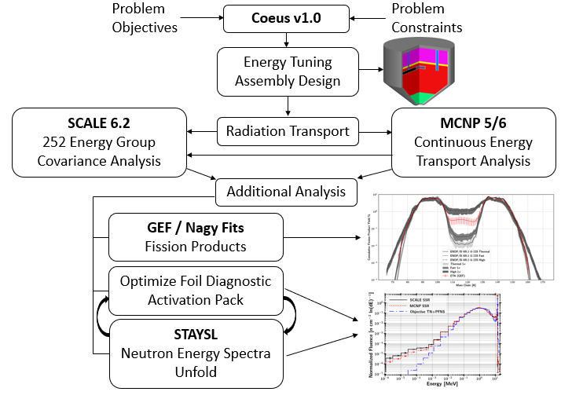
Prospectus Recap Methodology

Slide 11
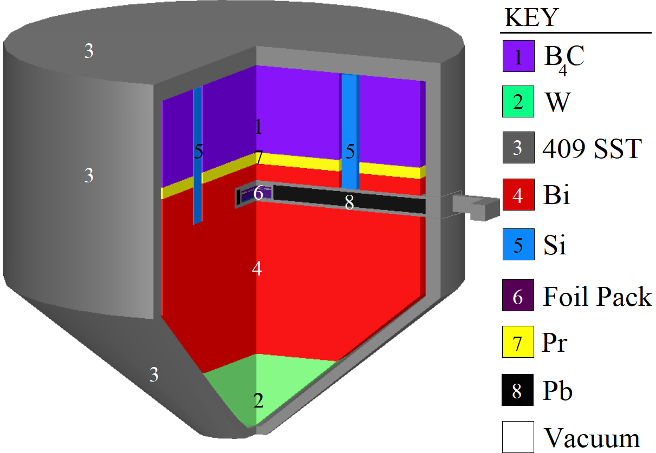
ETA Design

Slide 12
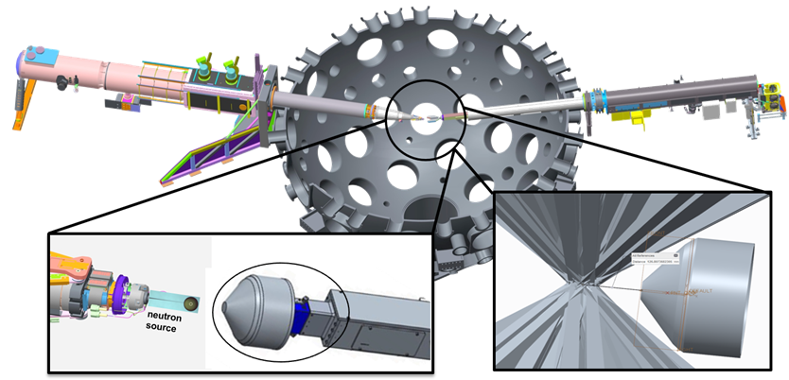
Full NIF Model Source Surface Read
Modeled Polar Drive Exploding Pusher (PDXP) Deuterium-Tritium neutron source
3.7 x 10¹⁵ 14 MeV neutron yield
Minimal downscatter compared indirect drive methods utilizing a hohlraum
NIF Neutron Source with Mounted ETA Incident Laser Exclusion Zone
Notes:
including the target positioner (TARPOS), Target and Diagnostic Manipulator (TANDM) with ETA and diagnostic snout, polar diagnostic instrument manipulator (DIM), and target chamber with first panel walls

Slide 13
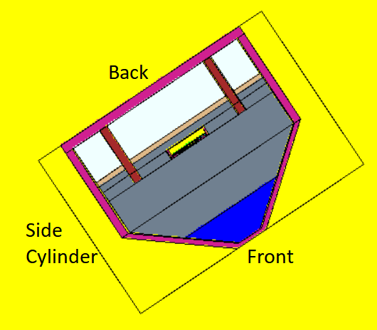
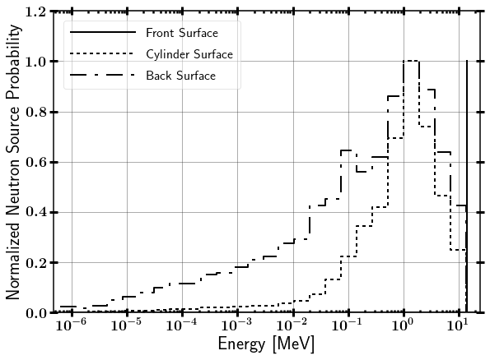
SCALE source from Full NIF model MCNP SSR
Continuous energy (CE) MCNP5 solution is mapped to SCALE CE MAVRIC with current tallies
Notes:
including the target positioner (TARPOS), Target and Diagnostic Manipulator (TANDM) with ETA and diagnostic snout, polar diagnostic instrument manipulator (DIM), and target chamber with first panel walls

Slide 14
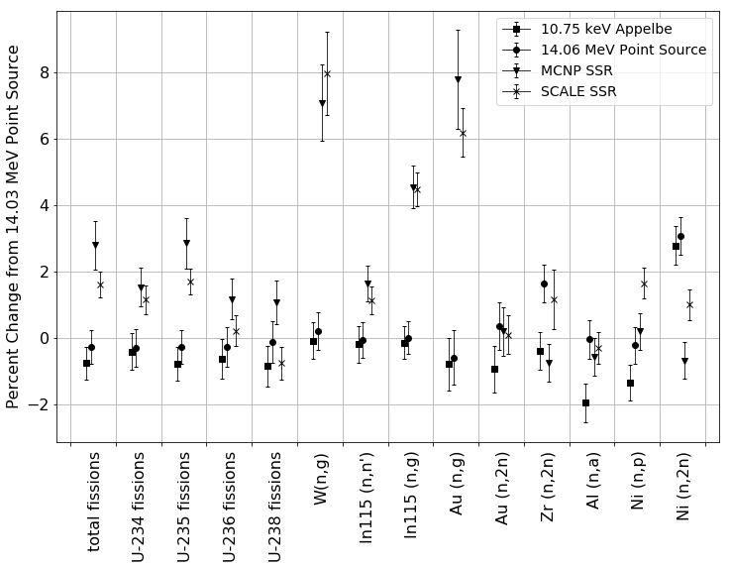
Importance of source characterization
Notes:
Threhold reactions (n,2n), (n,a), and (n,n’) increase with increasing neutron incident energy.
Non-threshold reactions (n,f) and (n,g) increase with including room return

Slide 15
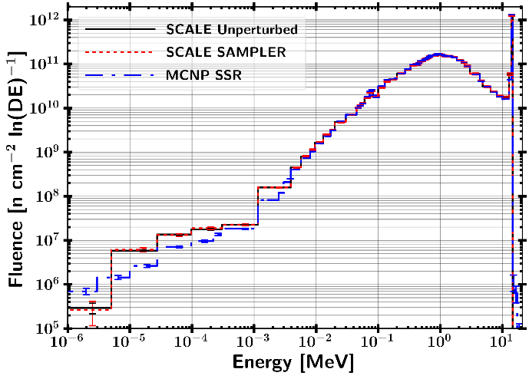
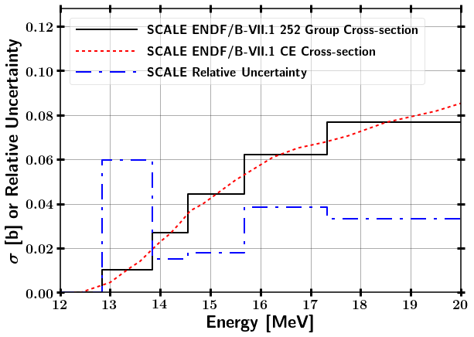
Combining Responses from Perturbed Nuclear Data
Uncertainty from
Statistical
Neutron transport
Foil activation data
Ni-58 (n,2n)
15

Slide 16
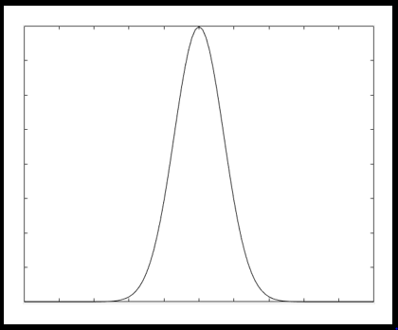
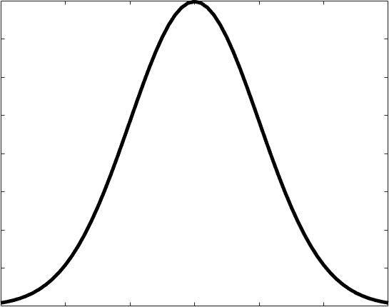
Combining Responses from Perturbed Nuclear Data
Uncertainty from
Statistical
Neutron transport
Foil activation data
SCALE Sampler Module (Neutron Transport)
Unperturbed
Response
N Sampled Responses with Perturbed Nuclear Data
Ni-58 (n,2n)
16

Slide 17
Combining Responses from Perturbed Nuclear Data
Uncertainty from
Statistical
Neutron transport
Foil activation data
SCALE Sampler Module (Neutron Transport)
Unperturbed
Response
N Sampled Responses with Perturbed Nuclear Data
IRDFF Nuclear Data Covariance
Ni-58 (n,2n)
17

Slide 18
SCALE Sampler Module (Neutron Transport)
Unperturbed
Response
N Sampled Responses with Perturbed Nuclear Data
IRDFF Nuclear Data Covariance
Insert MCNP
Statistical Uncertainty
Combine Data with Bootstrapping
Final Response
18

Slide 19
Combining Responses from Perturbed Nuclear Data
Uncertainty from
Statistical
Neutron transport
Foil activation data
SCALE Sampler Module (Neutron Transport)
Unperturbed
Response
N Sampled Responses with Perturbed Nuclear Data
IRDFF Nuclear Data Covariance
Insert MCNP
Statistical Uncertainty
Combine Data with Bootstrapping
Ni-58 (n,2n)
Final Response
19

Slide 20
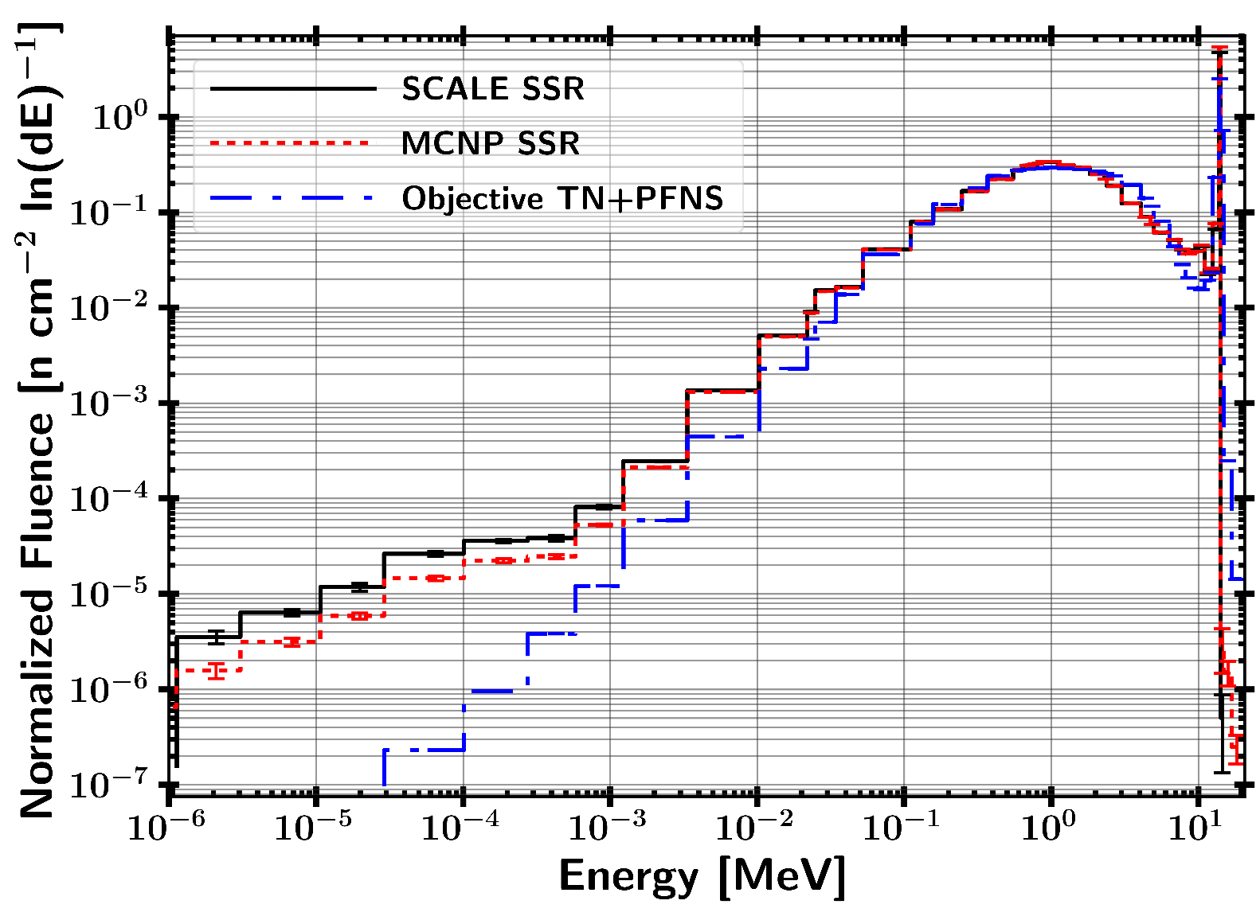
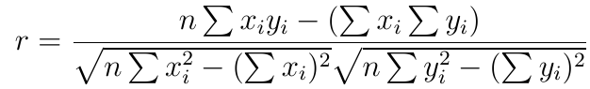
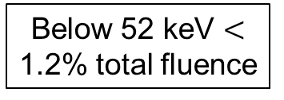
Current Results SSR Source Mapping to SCALE
Below 52 keV $<$ 1.2% total fluence
r(MCNP,Obj) = 0.90
r(MCNP,SCALE)= 0.9999
Pearson Correlation Coefficient:

Slide 21
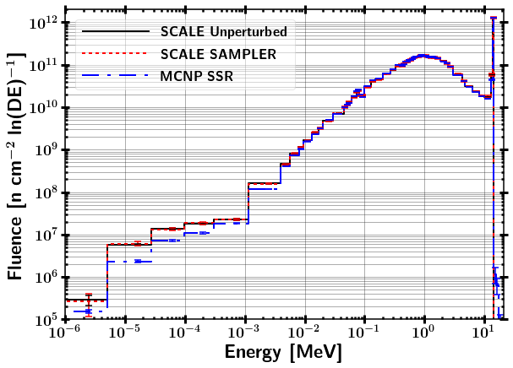
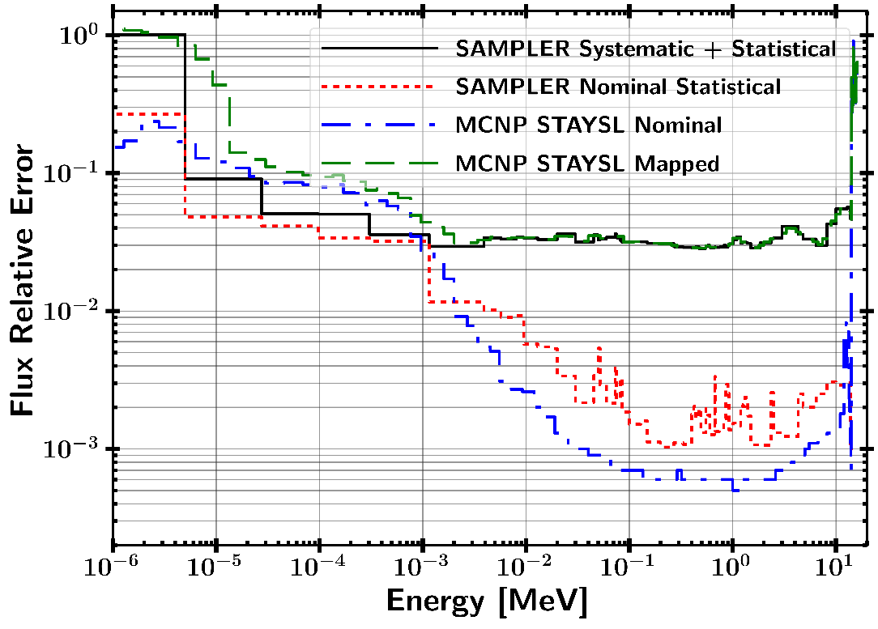
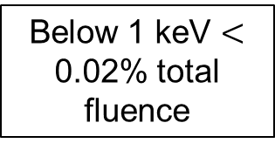
SCALE SAMPLER Fluence Results
Fluence Spectra Comparison Fluence Uncertainty
Below 1 keV $<$ 0.02% total fluence
118 Samples from Sampler

Slide 22
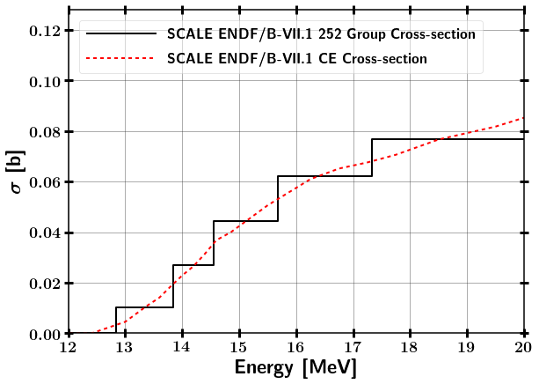
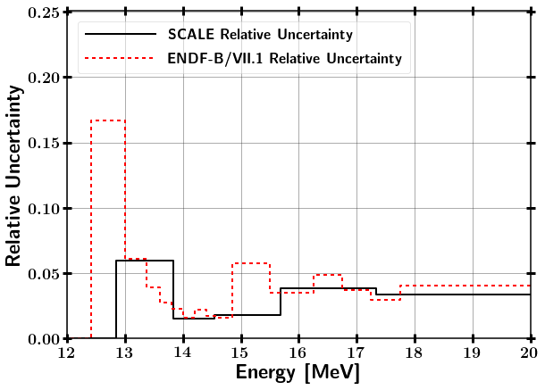
Test Case - Mapping SAMPLER Uncertainty to alternate bin structure
⁵⁸Ni(n,2n) comparison between SCALE 252 Group and CE
1 n/cm²-s flux scaled by bin width from 12.4 – 14 MeV
Notes:
Assumed pure ⁵⁸Ni, 1 cc, and N = 10²⁴ at/cc
1 n/cm²-s flux scaled by bin width from 12.4 – 14 MeV

Slide 23
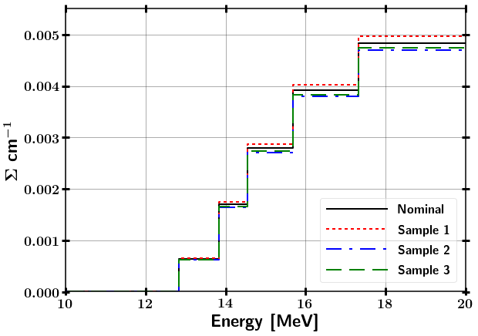
Test Case - Mapping SAMPLER Uncertainty to alternate bin structure
⁵⁸Ni(n,2n) comparison between SCALE 252 Group and CE
1 n/cm²-s flux scaled by bin width from 12.4 – 14 MeV
Ni-58 (n,2n) SAMPLER Samples
Sample Cross-section
Notes:
Assumed pure ⁵⁸Ni, 1 cc, and N = 10²⁴ at/cc
1 n/cm²-s flux scaled by bin width from 12.4 – 14 MeV

Slide 24
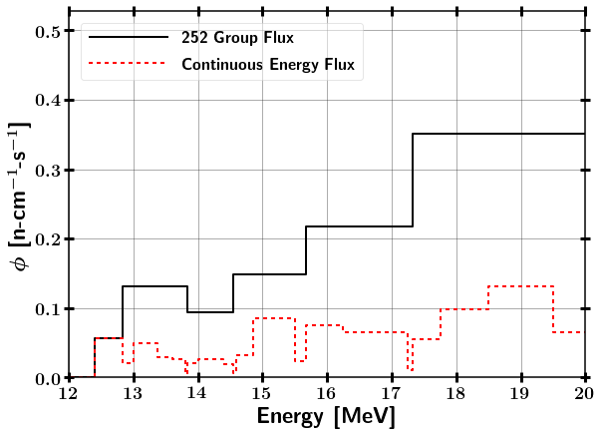
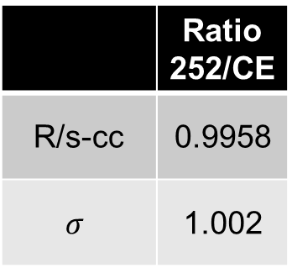
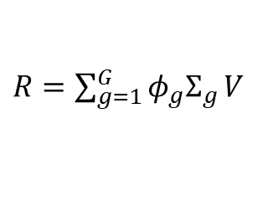
Test Case - Mapping SAMPLER Uncertainty to alternate bin structure
⁵⁸Ni(n,2n) comparison between SCALE 252 Group and CE
1 n/cm²-s flux scaled by bin width from 12.4 – 14 MeV
Ni-58 (n,2n) SAMPLER Samples
Sample Cross-section
$R=\sum_{g=1}^{G}{{φ_{g}Σ}_{g}}V$
 | Ratio 252/CE
R/s-cc | 0.9958
$$σ$$ | 1.002
Notes:
Assumed pure ⁵⁸Ni, 1 cc, and N = 10²⁴ at/cc
1 n/cm²-s flux scaled by bin width from 12.4 – 14 MeV

Slide 25
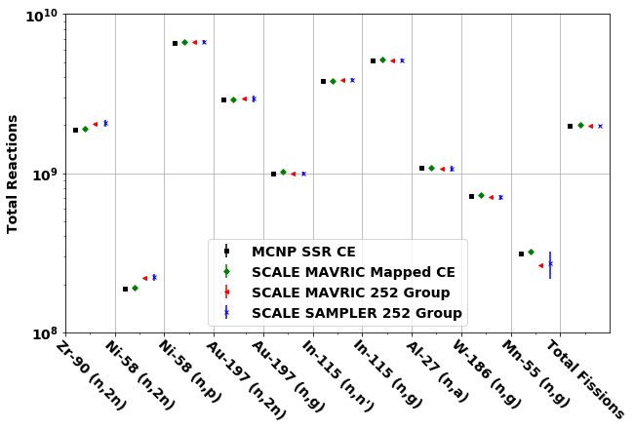
Activation Foil Pack Results
Additional Foils Considered: Cu, Nb, Ti, Sc, Fe, Co, Dy
Not utilized due to half-life, competing reaction channels, low reaction rates, or not well characterized nuclear data.

Slide 26
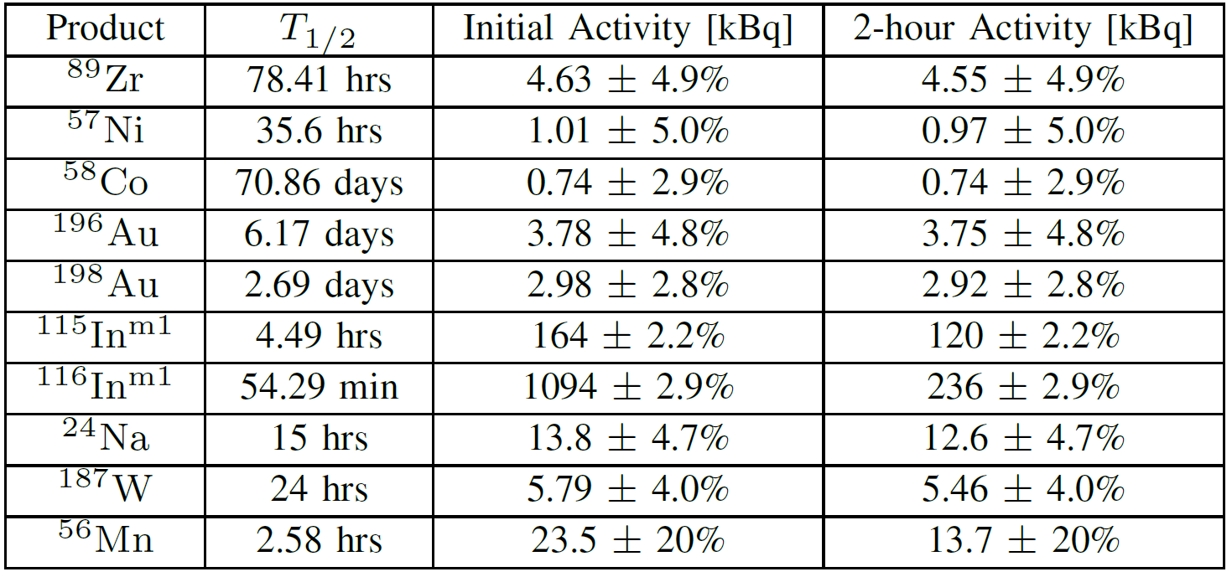
Activation Foil Pack Results

Slide 27
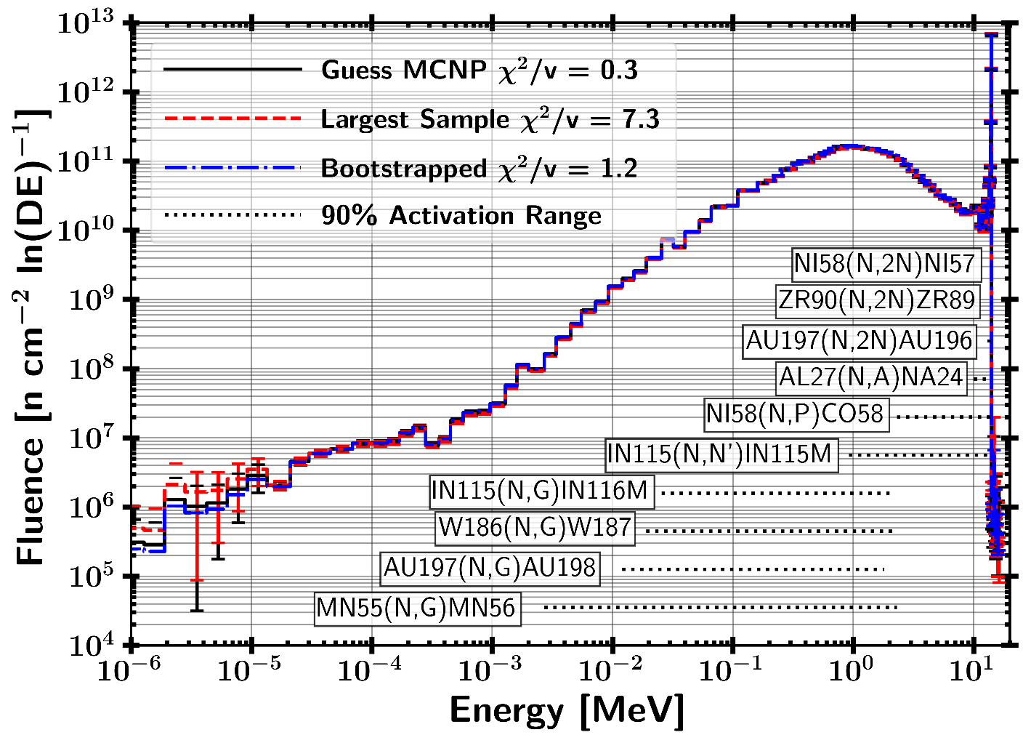
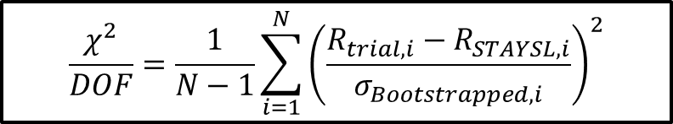
STAYSL Unfolded Spectrum
118 Sampled Spectra
77.1% of trials were not-rejected with a p-value greater than 0.1
22.9% of trials were rejected with a p-value lower than 0.1
$$\frac{χ^{2}}{DOF}=\frac{1}{N−1}\sum_{i=1}^{N}{{\left(\frac{R_{trial,i}−R_{STAYSL,i}}{σ_{Bootstrapped,i}}\right)}^{2}}$$

Slide 28
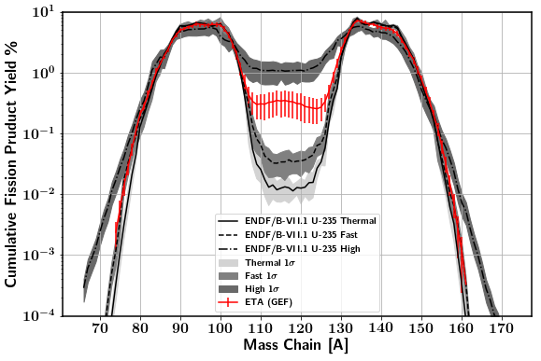
GEF Fission Product Mass Chains

Slide 29
Path Forward
Finish Analysis Methods (30 November)
Nuclear data uncertainty
Short pulse neutron source
Nagy Fits
Sampler Complete (7 December) (Running in background)
Submit to Transactions on Nuclear Science (14 December)
Thesis (21 December)
Notes:
Assumed pure ⁵⁸Ni, 1 cc, and N = 10²⁴ at/cc
1 n/cm²-s flux scaled by bin width from 12.4 – 14 MeV

Slide 30
BACKUPS

Slide 31
Research Problem (ETA)
FY2019 NIF Shot (ETA)
Quantify the impact of nuclear data covariances of the simulated results for the neutron energy spectrum, foil activation rates, and fission product production rates
Design a foil activation diagnostic pack to provide better resolution in the epithermal neutron energy range
Prioritize and estimate production of fission products for radio-chemical analysis using recently published data

Slide 32
Questions and Hypothesis (ETA)
2019 ETA Fission Product Experiment
What is the impact of nuclear data covariance on the simulated results?
Does the activation foil pack have sufficient coverage of the neutron spectrum to be used for unfolding?

Slide 33
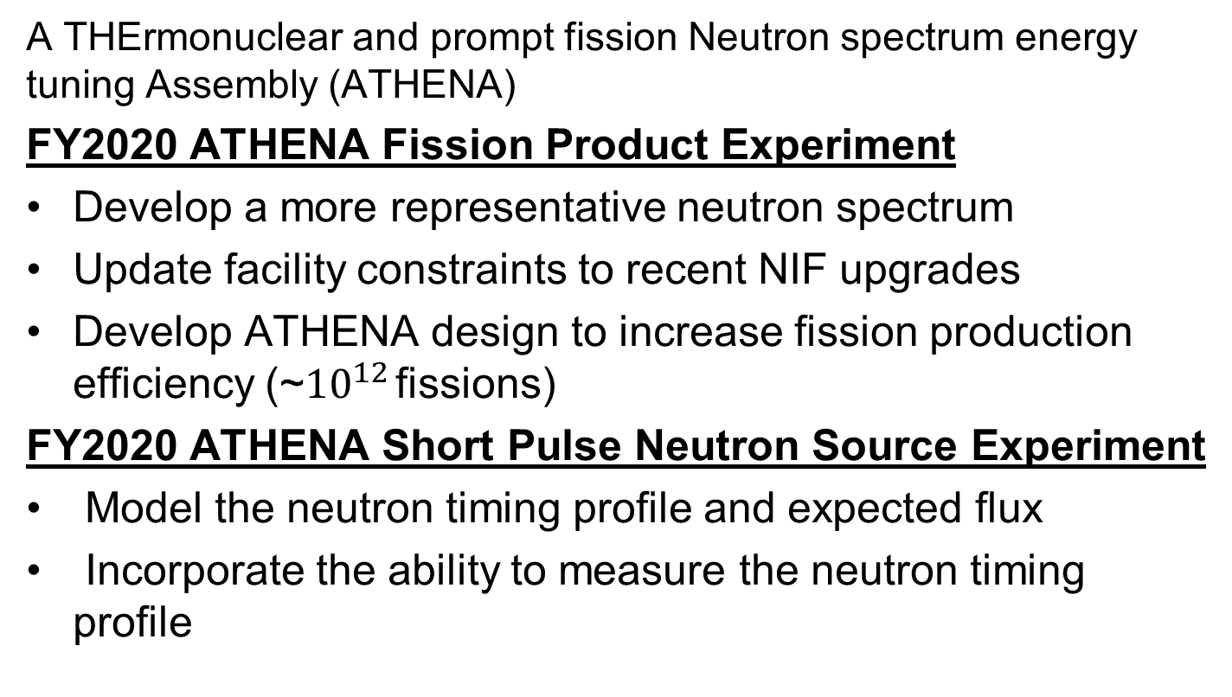
Research Problem (ATHENA)
A THErmonuclear and prompt fission Neutron spectrum energy tuning Assembly (ATHENA)
FY2020 ATHENA Fission Product Experiment
Develop a more representative neutron spectrum
Update facility constraints to recent NIF upgrades
Develop ATHENA design to increase fission production efficiency (~${10}^{12}$ fissions)
FY2020 ATHENA Short Pulse Neutron Source Experiment
Model the neutron timing profile and expected flux
Incorporate the ability to measure the neutron timing profile

Slide 34
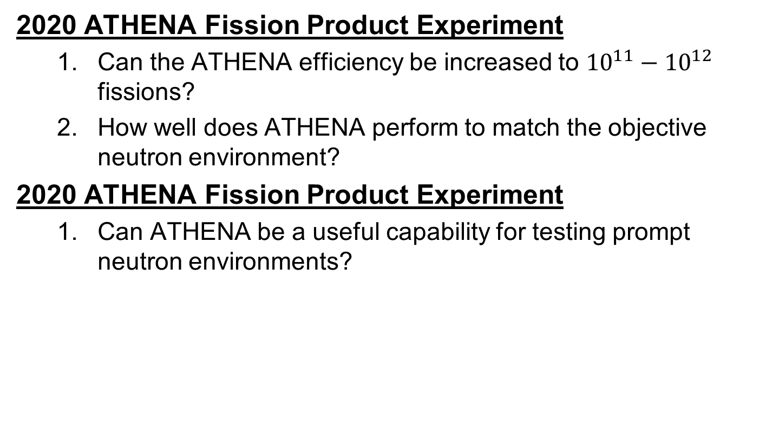
Questions and Hypothesis (ATHENA)
2020 ATHENA Fission Product Experiment
Can the ATHENA efficiency be increased to ${10}^{11}−{10}^{12}$ fissions?
How well does ATHENA perform to match the objective neutron environment?
2020 ATHENA Fission Product Experiment
Can ATHENA be a useful capability for testing prompt neutron environments?

Slide 35
Assumptions and Limitations
Nuclear data
Unclassified nuclear weapon spectrum
NIF neutron source
TN+PFNS
Nuclear weapon environment
Not analyzed at weapon temperatures
No temporal dependence
No fractionation

Slide 36
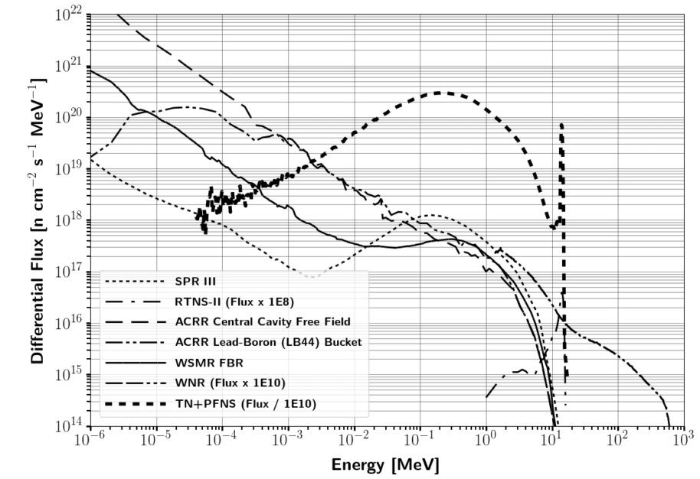
Capability gap in reproducing nuclear weapon environments
Notes:
A key consideration for testing is the neutron energy spectrum in comparison with the environment that a nuclear weapon would see or produce.
A particular spectrum of interest is the combination of a thermonuclear (TN) and prompt fission neutron spectrum (PFNS) as the present testing does not address this region to a large extent.
The vast majority of testing facilities are focused on the Watt-fission spectrum, while a few are capable of producing the 14.1 MeV TN component from the deuterium-tritium (DT) fusion process\cite{Bridgman}.
The current prompt neutron facilities available are not well suited for the TN+PFNS application testing because of the lack of high energy neutrons, or there is not a large enough flux of neutrons on target.
Several examples of testing facilities for prompt neutrons outlined in Table \ref{tab:NWECap} are the Sandia Pulsed Reactor III (SPR), Sandia Annual Core Research Reactor (ACCR), White Sands Missile Range (WSMR) Fast Burst Reactor (FBR), and the Los Alamos National Laboratory (LANL) Rotating Target Neutron Source (RTNS).
The differential spectral profile of these sources compared to a notional TN+PFNS is shown in Figure \ref{fig:CompSource}. the LANL Weapons Neutron Research facility (WNR).

Slide 37
Theory
Neutron Interactions with Matter
Fission Theory / Fission Products
Monte Carlo Neutron Transport
Foil Activation
Neutron Energy Spectrum Unfolding
Optimization
Nuclear Data Covariance
* Bold indicates that it is included in this brief

Slide 38
Fission Process
Fission fragments (prompt decay) → Fission Products

Slide 39
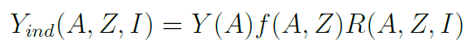
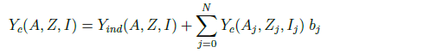
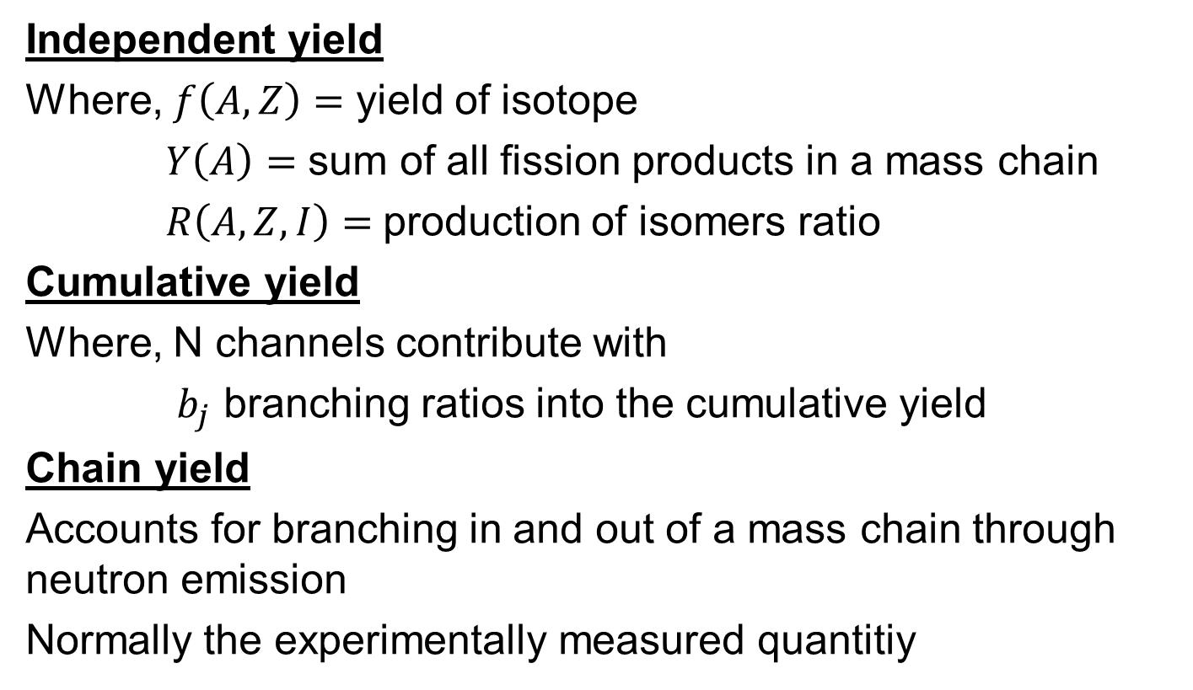
Fission Yields
Independent yield
Where, $f\left(A,Z\right)=$ yield of isotope
$Y\left(A\right)=$ sum of all fission products in a mass chain
$R\left(A,Z,I\right)=$production of isomers ratio
Cumulative yield
Where, N channels contribute with
$b_{j}$ branching ratios into the cumulative yield
Chain yield
Accounts for branching in and out of a mass chain through neutron emission
Normally the experimentally measured quantitiy

Slide 40
Fission Yields
U-235 thermal (n,f)

Slide 41
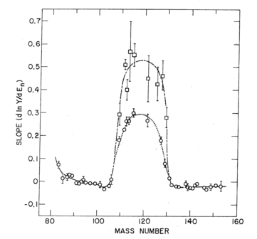
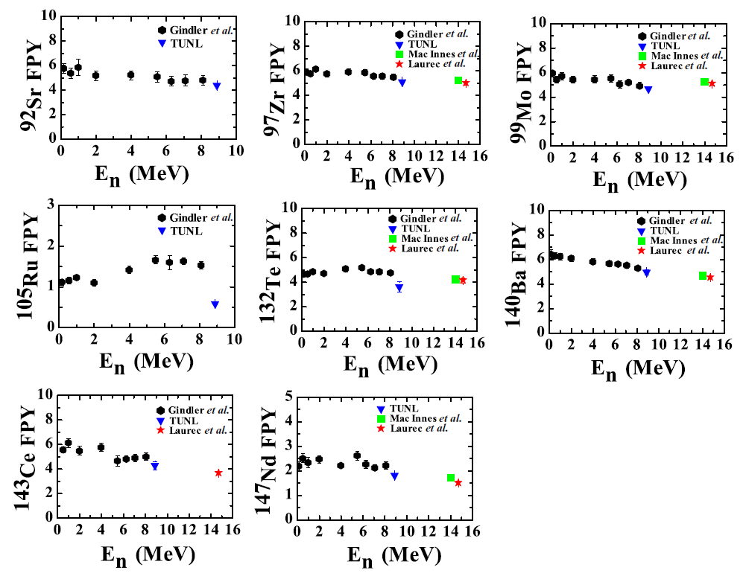
Fission Product Estimation
General Observables of Fission (GEF)
Fit to model (Nagy fits)

Slide 42
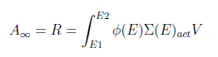
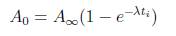
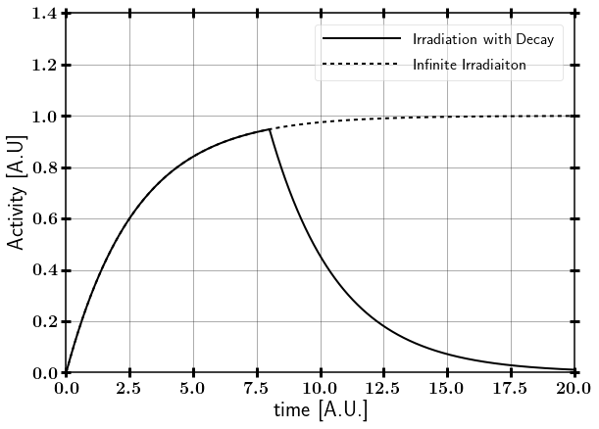
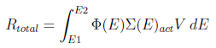
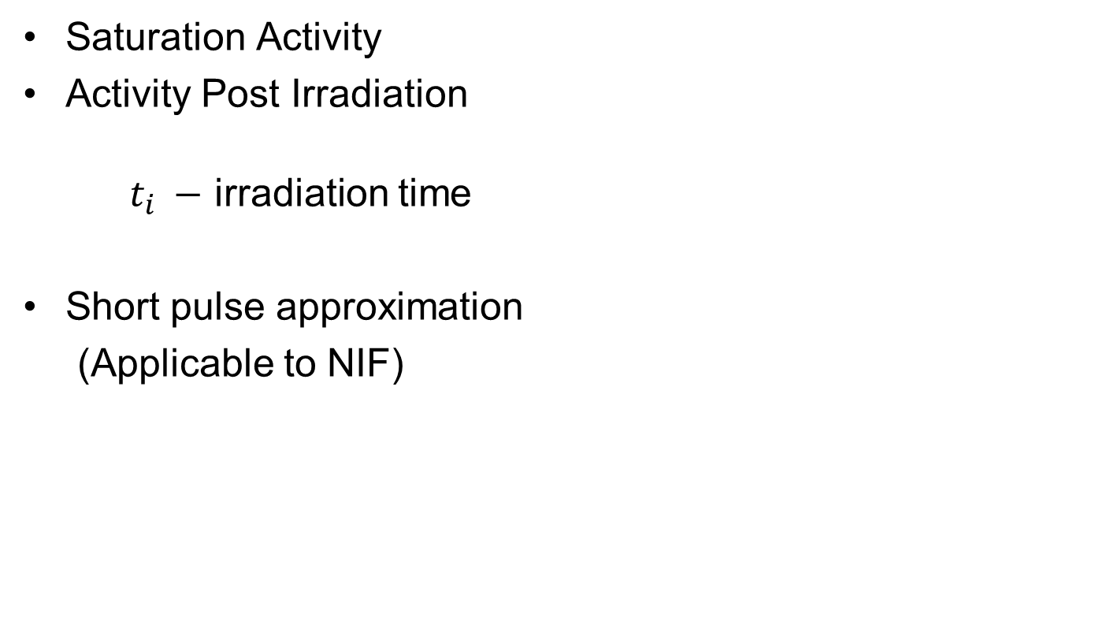
Foil Activation
Saturation Activity
Activity Post Irradiation
$t_{i} −$ irradiation time
Short pulse approximation
(Applicable to NIF)

Slide 43
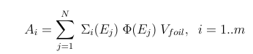
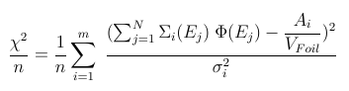
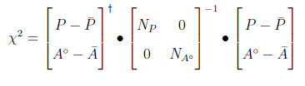
Unfolding Solution Methods
Matrix inversion
Least-square spectral adjustment (ex. PNNL STAYSL)
Incorporates uncertainty and an can incorporate covariance
Requires guess spectrum
Stochastic methods
P = Neutron flux and nuclear data
A = Activity
N =Covariance

Slide 44
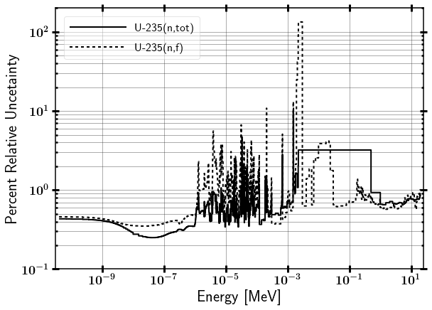

Nuclear Data Uncertainty

Slide 45

Previous Work
UC – Berkeley and LLNL developed energy tuning assembly (ETA).
Coeus metaheuristic optimization software package
Validation test at LBNL 88-Inch Cyclotron

Slide 46

Options to Generate Representative Nuclear Weapon Environments
Synthetic Fission Debris
Sample doping
Direct production using fission converters
Surrogate methods
Spectral modification
Neutron Effects on Electronics
Utilize existing sources
Models
Surrogate charged particle reactions

Slide 47
Overview
Introduction and Background
Theory
Methodology
Research Schedule
Future work

Slide 48

ATHENA Spectrum

Slide 49


SCALE source from MCNP SSR
Disk source - 0 to $π$ emission angles
4 line sources – 0 to $π$ emission angles
Point Source – 14.03 MeV and room return isotropic

Slide 50

Neutron interactions relevant to ETA design

Slide 51
Possible PHD follow on research areas
Analyze the actual ETA Experiment results (2019)
Incorporate fractionation of fission debris, work into ATHENA (2020 experiment).
Neutron flux unfolding technique using pre-built SCALE libraries

Slide 52

Research Schedule
Schedule risk: Computational resources and changing model

Slide 53

Research Schedule

Slide 54

Research Schedule

